Slide 1
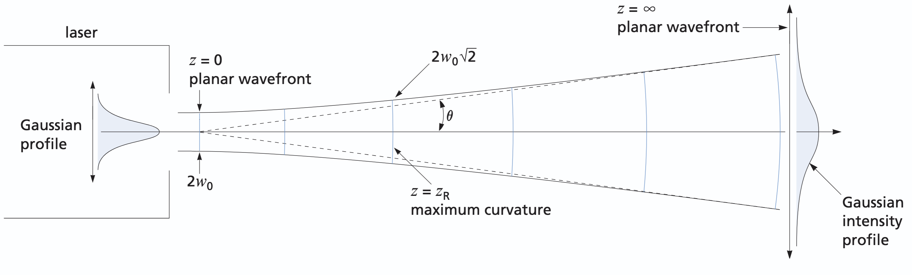
Propagation of Laser Light: Gaussian Beam optics
Parth Bhargava · A0310667E
In many cases, a laser beam appears to diverge in a conical shape, but most of the time intensity distribution can be approximated by an ideal Gaussian intensity profile.
The goal of this experiment was to verify whether the given laser follows the Gaussian intensity distribution and to calculate the M² value, a key indicator of beam quality.
Notes:
Good afternoon Gentlemen, today I will be presenting on the propagation of laser light. So, in most laser application,
the beam can be estimated as a Gaussian beam, and the task is to investigate how the spot size increases with increasing distance, and to determine the M^2 parameter
of the laser.

Slide 2
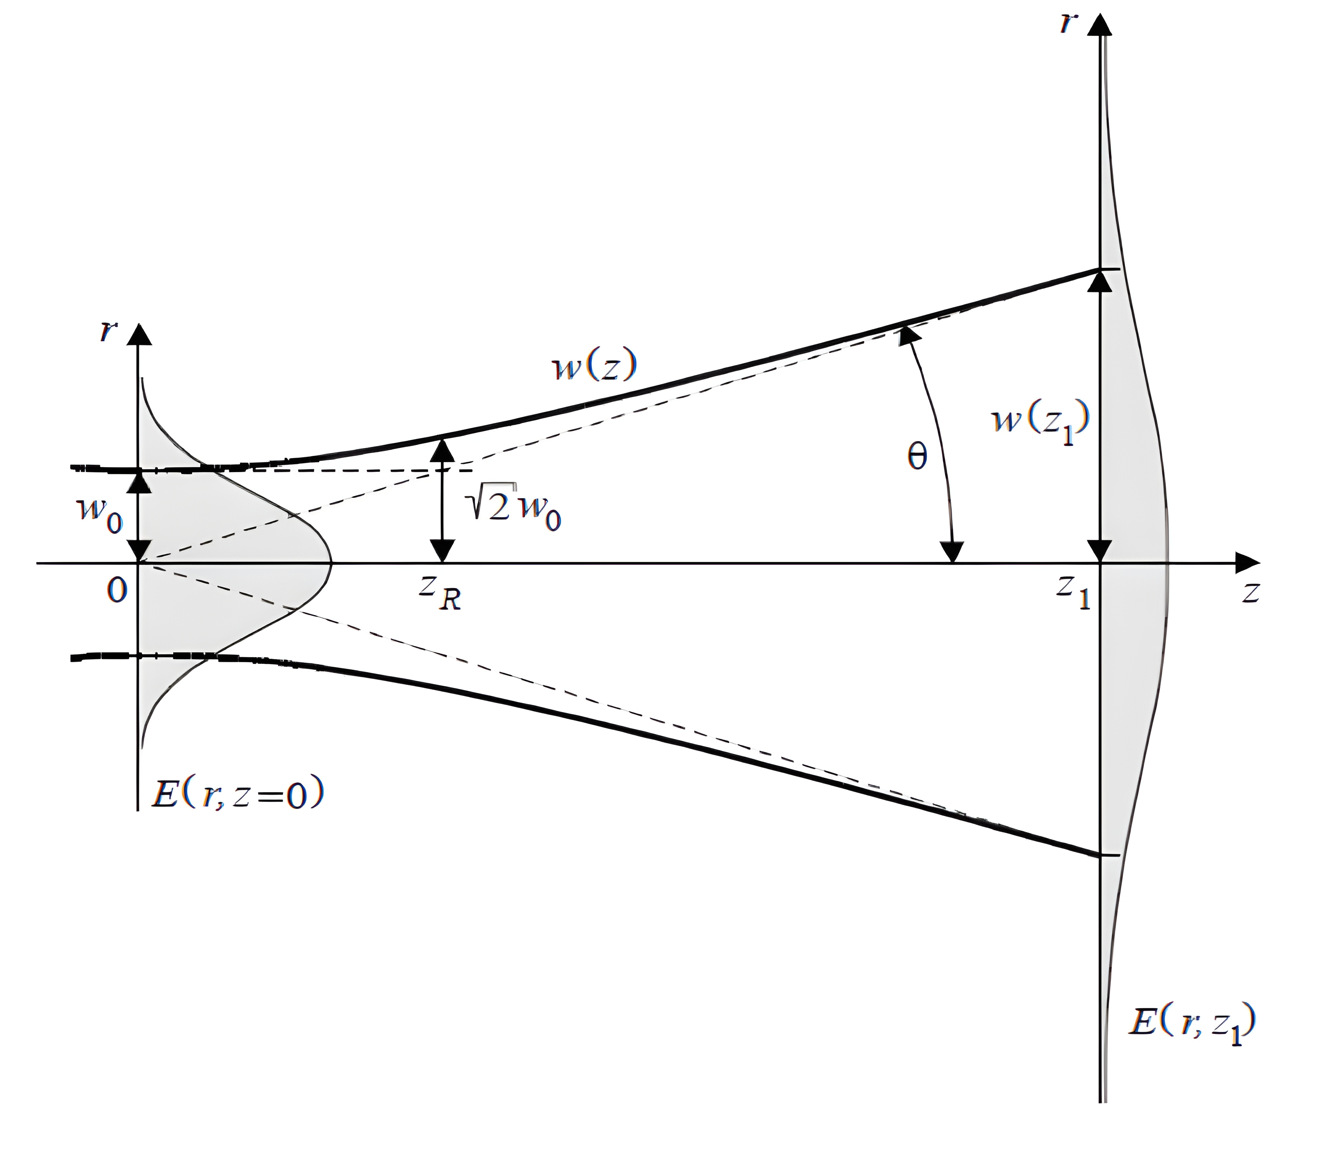
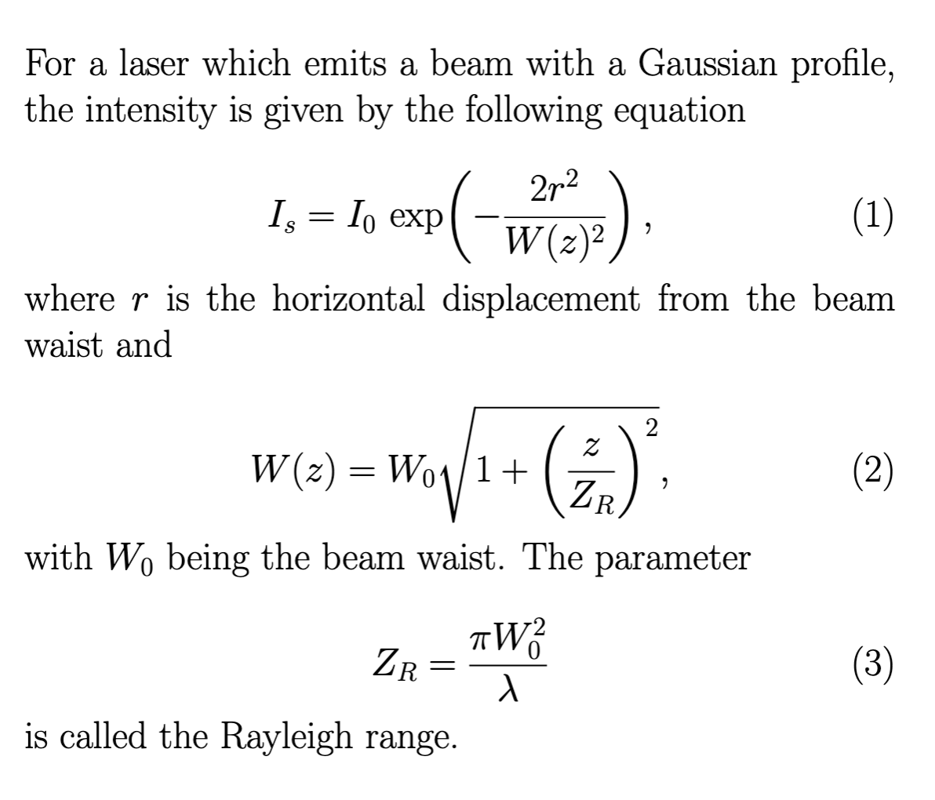
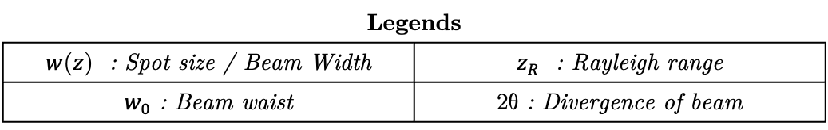
Introduction
Schematic on spot size expanding on propagation.
Legends
$w(z)$ : Spot size / Beam Width | $z_{R}$ : Rayleigh range
$w_{0}$: Beam waist | $2θ$: Divergence of beam
Notes:
So... what is a guassian beam? Essentially, gaussian beams are well bundled light ray that diverge very slowly over a long distance. They are symmetric about the axis and initially they look like this. So this is the spot size or beam waist, and as the distance increases, you can see that it increases hyperbolically. In the far field approximation, the asympotete angle is also commonly known as the divergence of the beam. It is characterized by lambda, and z_R. Here, we have defined the Rayleigh range as the distance for the spot size to increase by square root 2.

Slide 3
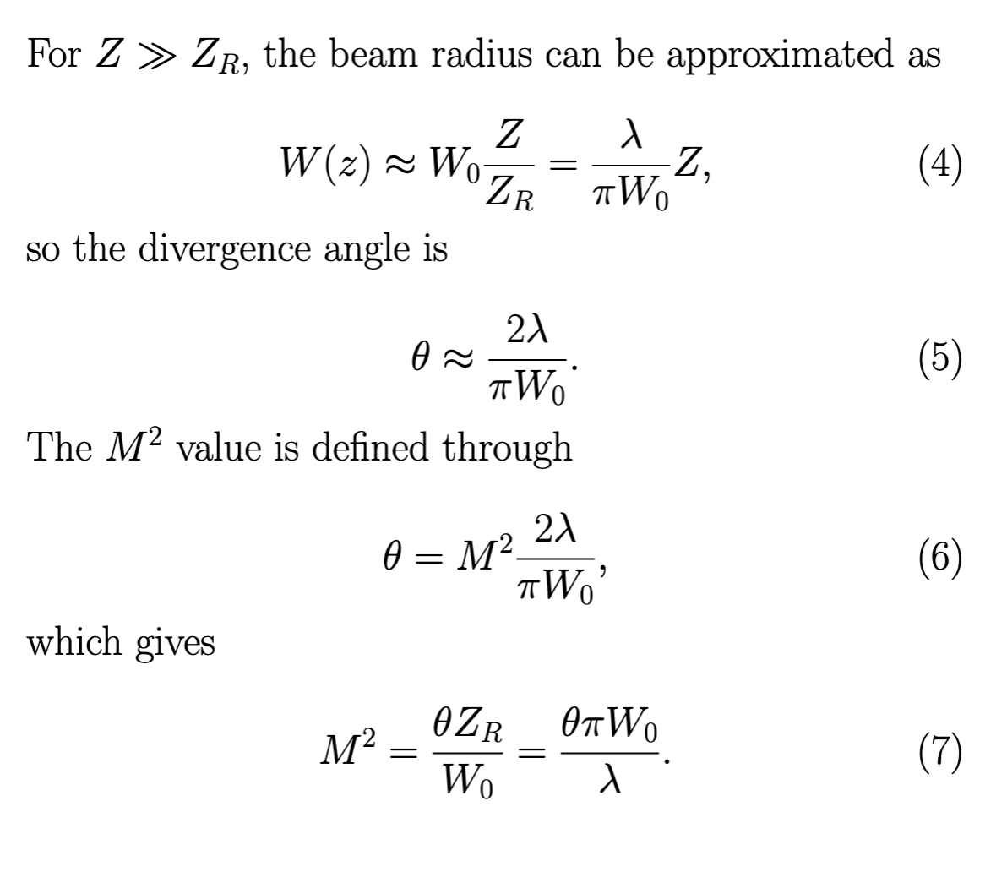
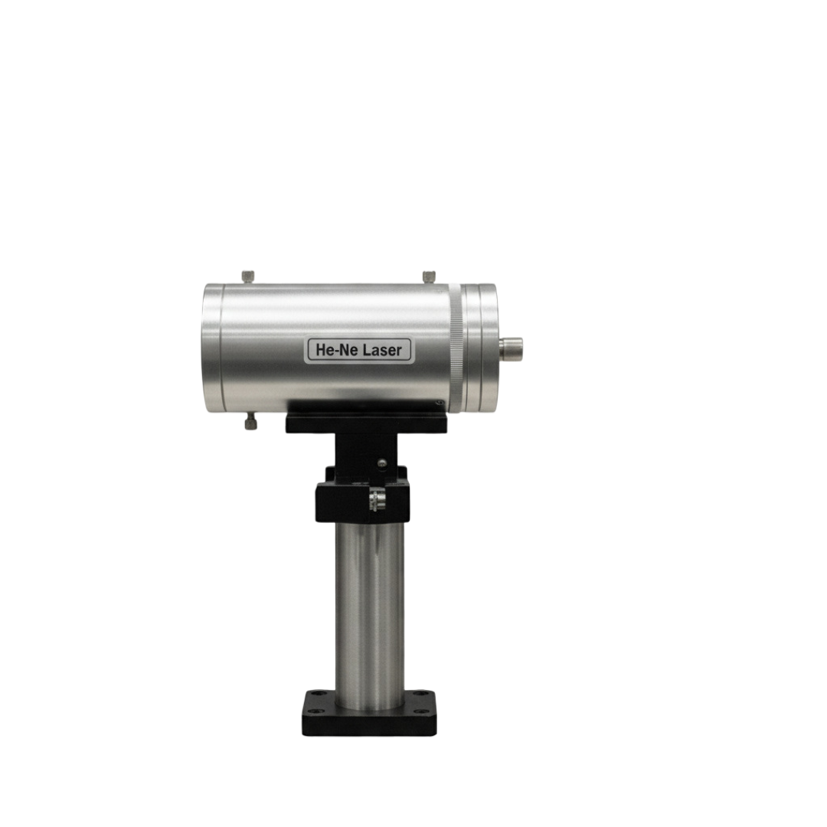
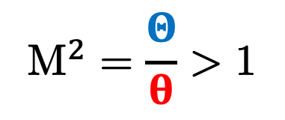
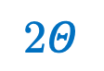
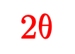
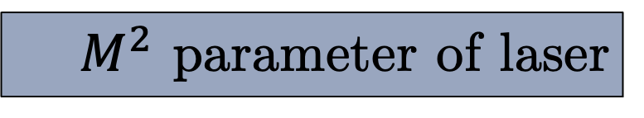
$M^{2}$ parameter of laser
$$2θ$$
In reality, lasers are not perfect Gaussian beams....
$$2Θ$$
$$M^{2}=\frac{Θ}{θ}>1$$
λ=632.8 nm
Legends | 2$Θ$ : Actual Angular Spread | 2$θ$: Predicted Divergence
Notes:
But in reality, lasers are not ideal Gaussian beams. We see that its angular spread is greater than the predicted divergence. Hence, scientist has defined a parameter M^2 as a measure of how ideal the laser is to a guassian beam. That is our objective for this experiment.

Slide 4
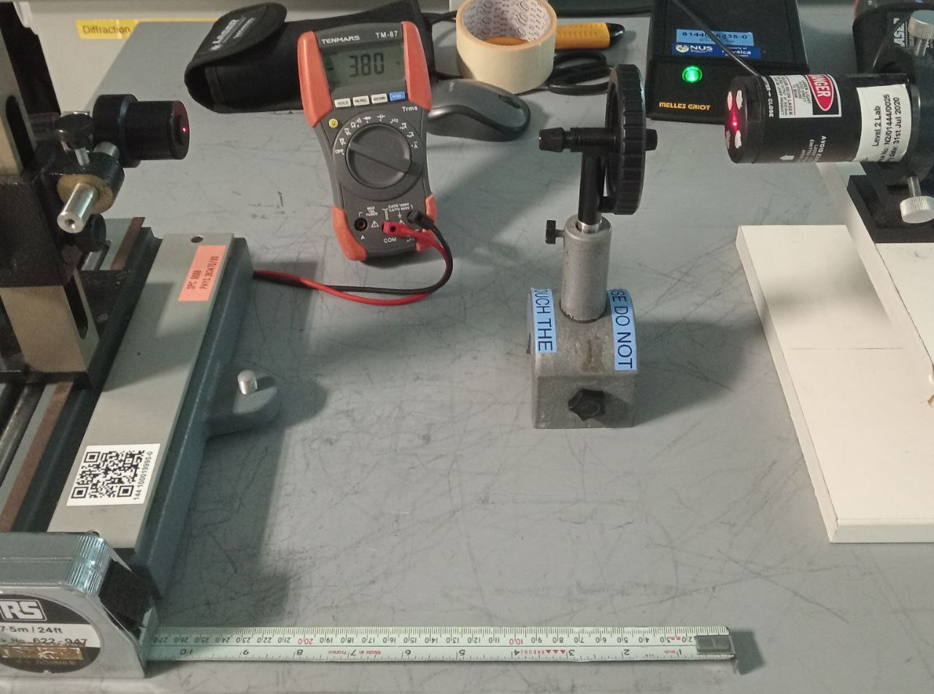
Experimental Setup
Legends
1 : Laser Source
2 : Attenuator
3 : Detector
4 : Voltmeter
5 : Measuring Tape
4
3
1
2
Determination of Rayleigh Range
Picture of Experimental Setup
z : 20 cm - 200 cm
5
Determination of Angular Spread
z : 5 m - 15 m
Notes:
First the laser shoot a beam and if need be, we put a polariser to decrease the intensity, then the beam hits the detector which will send a signal to the voltmeter. Now the detector is micrometer stage mounted detector so we can adjust the knob to shift the detector left and right. This will allow us to plot the gaussian shape of the beam. To effectively determine the rayleigh range, we vary the distance between the laser and the detector. This was done in the range of 10cm to 90cm, which turns out to be within the Rayleigh range. Next the determination of M^2 parameter was done at distance much greater than the Rayleight range, such as 10 to 18m.

Slide 5
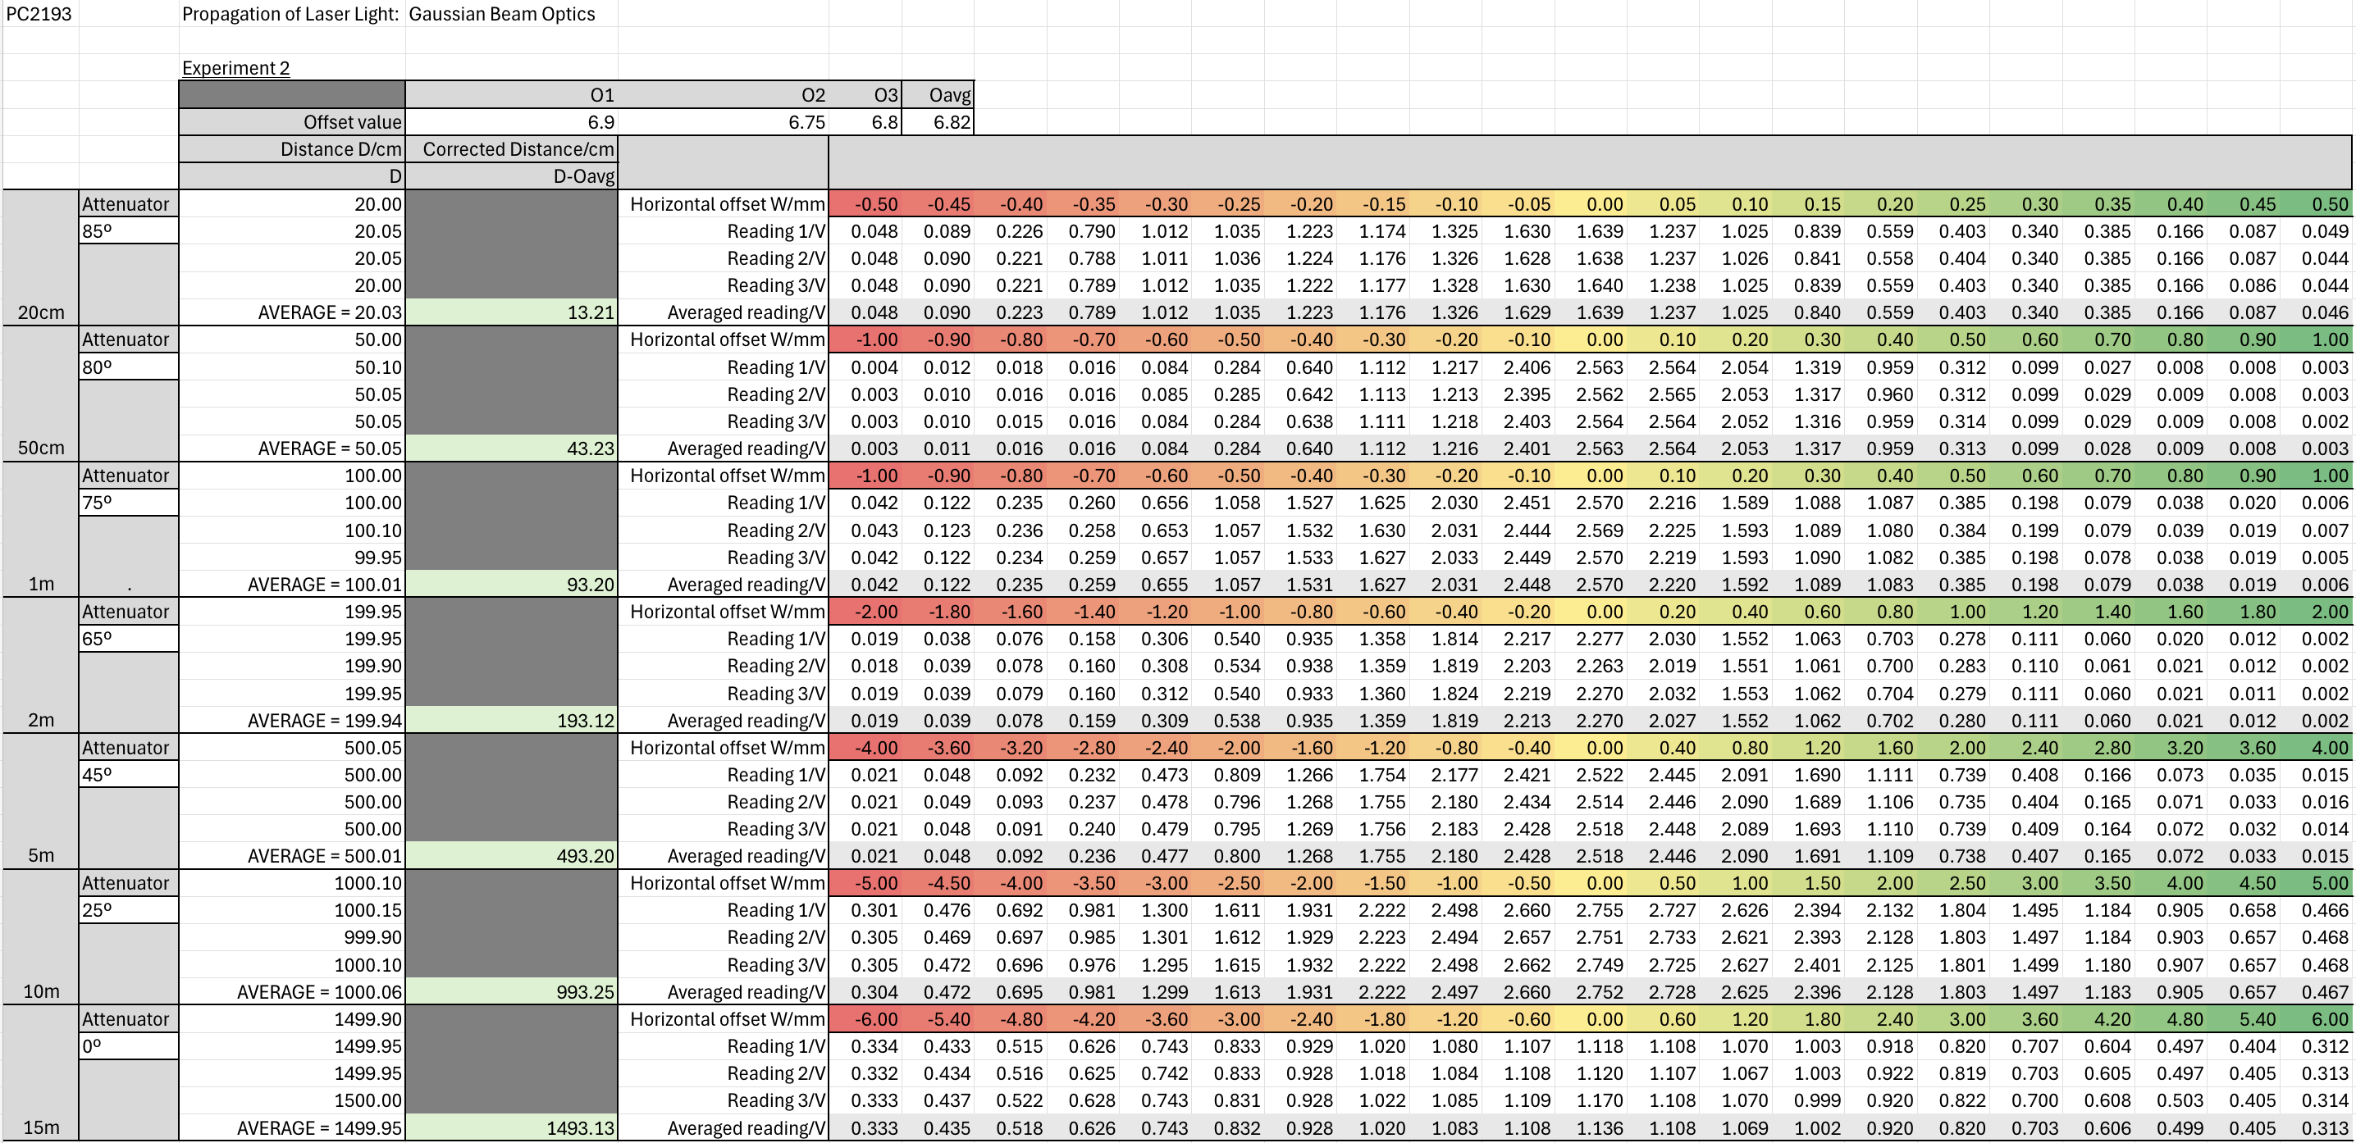
Raw Data
Notes:
Here are some of our preliminary data for the laser. As you can see the intensity follows the gaussian curve quite nicely. Here, it must be noted that the intensity is scaled using the polariser so the units are arbitrary.

Slide 6
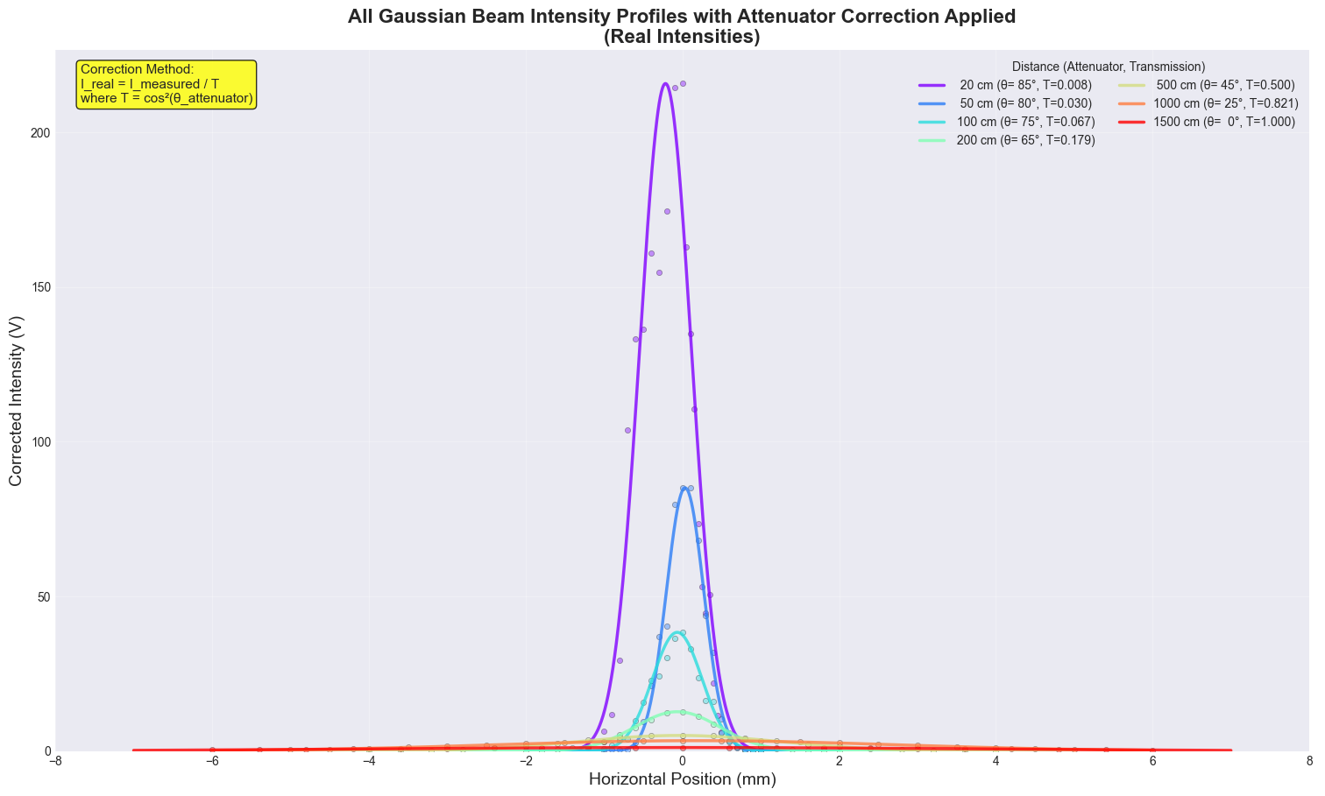
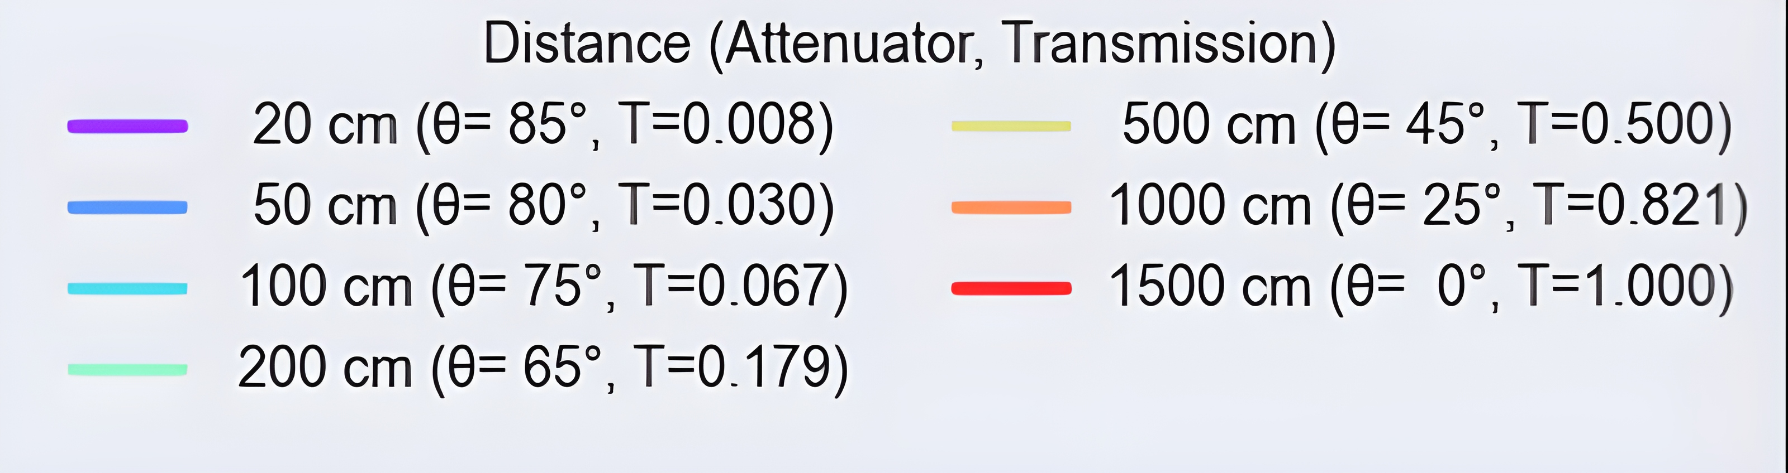
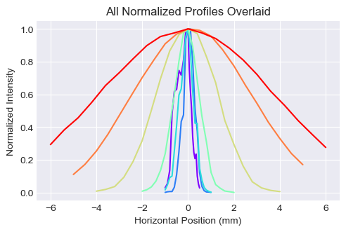
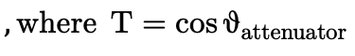
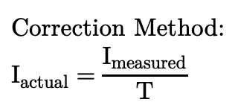
All Gaussian Intensity Profiles with Attenuator Correction Applied
$$Correction Method: \\ I_{actual}=\frac{I_{measured}}{T}$$
$$,where T=\cos{θ_{attenuator}}$$
Notes:
Here are some of our preliminary data for the laser. As you can see the intensity follows the gaussian curve quite nicely. Here, it must be noted that the intensity is scaled using the polariser so the units are arbitrary.

Slide 7
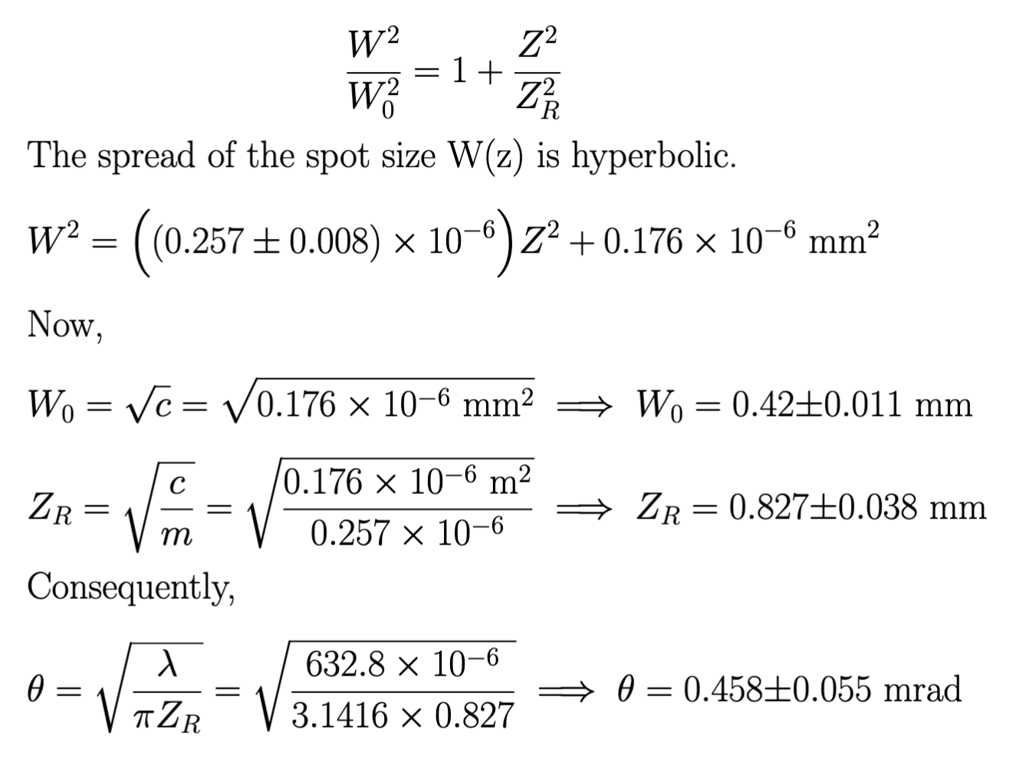
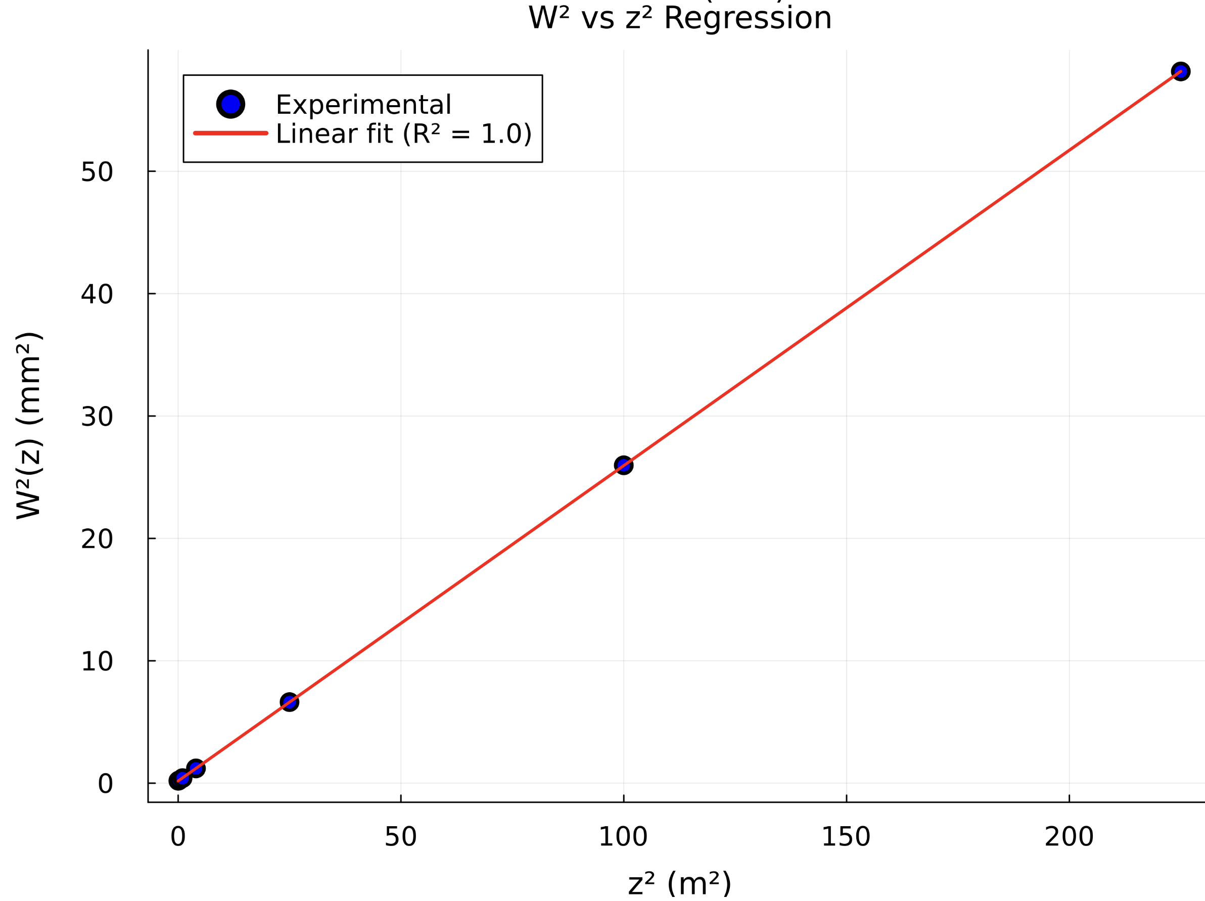
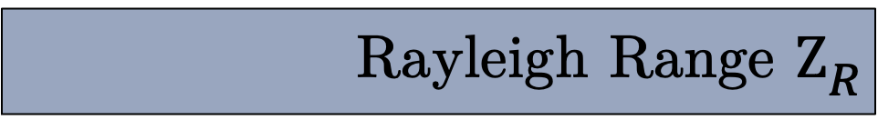
Rayleigh Range $Z_{R}$
Notes:
Now, we can with confidence, determine the rayleigh range for the laser. Since the beam width increases hyperbolically, we plot the graph of w^2 against z^2. The rayleigh range can be obtained by taking the square root of the intercept over gradient. Similarly, our asymptote angle, or half of the divergence is found to be

Slide 8
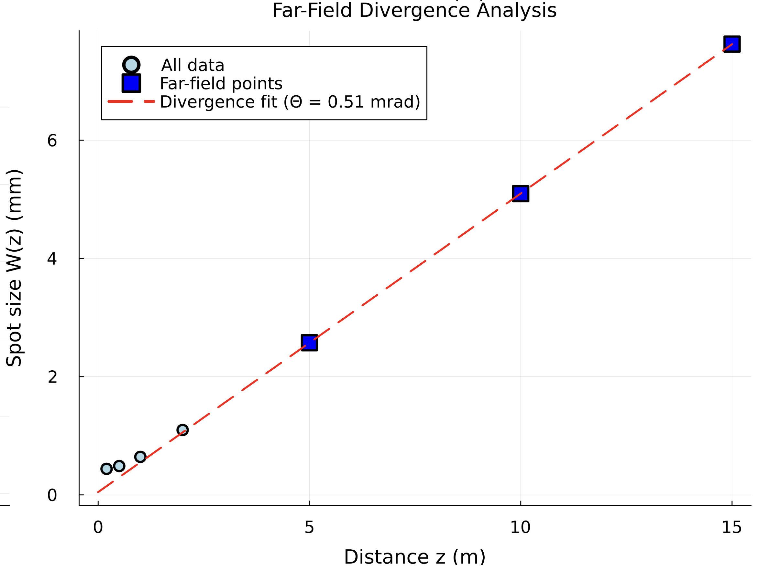
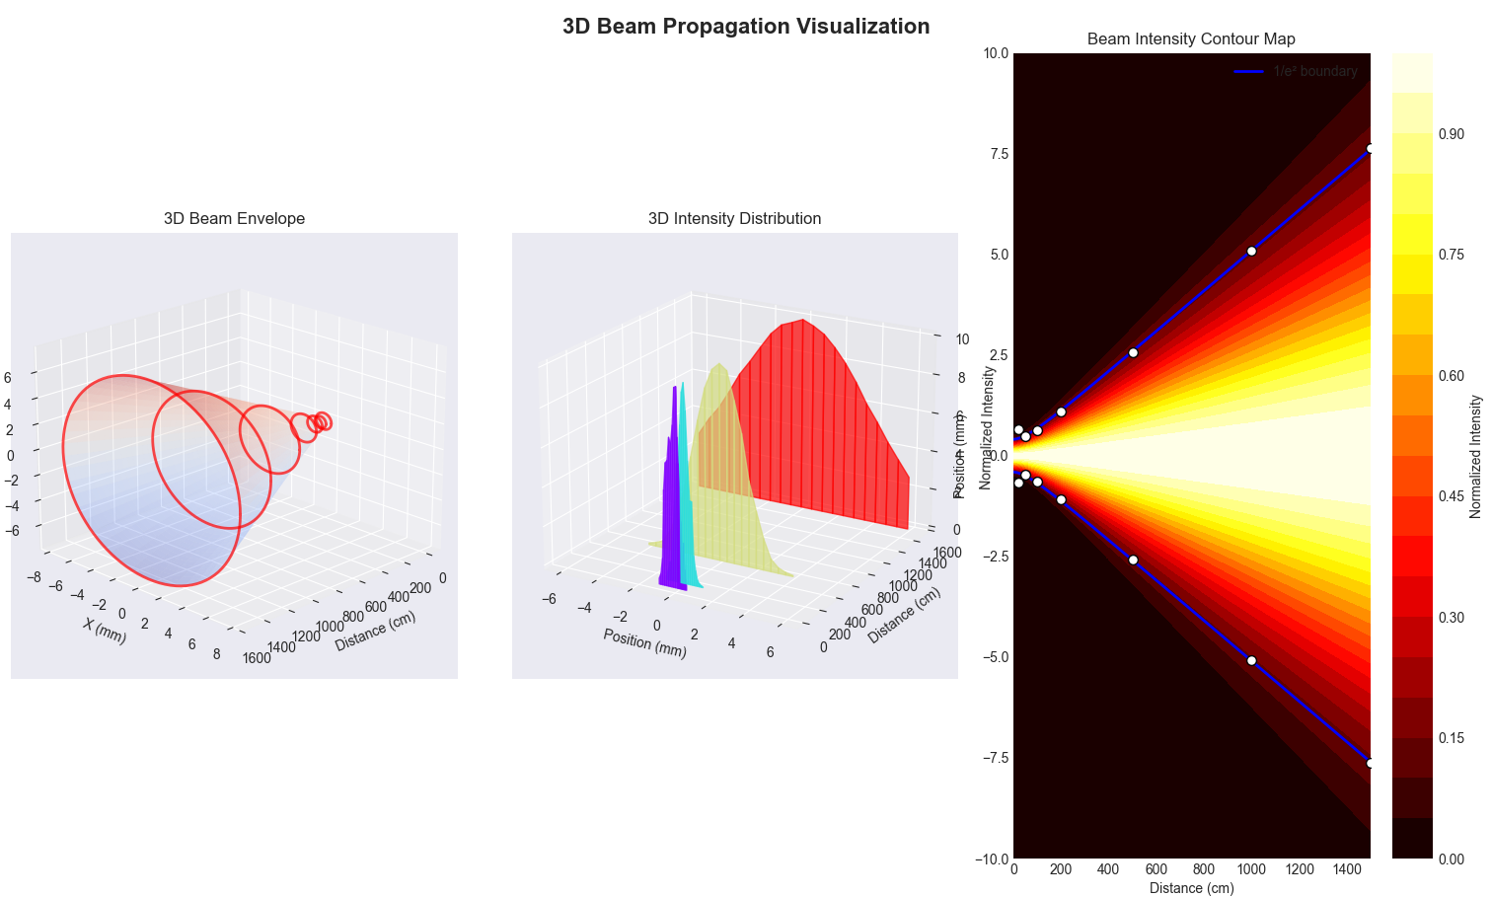
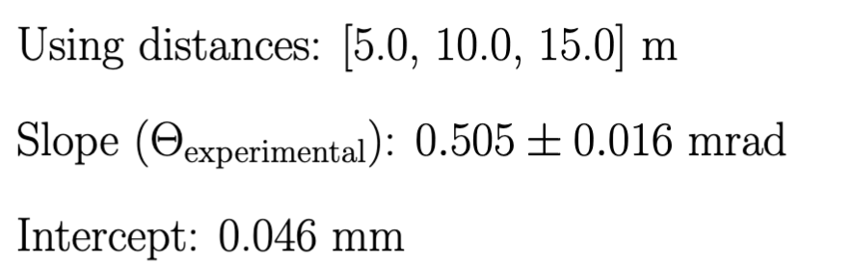
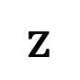
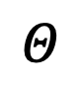
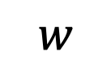
Determination of 𝜣 (Far Field)
$$w$$
$$Θ$$
$$z$$

Slide 9
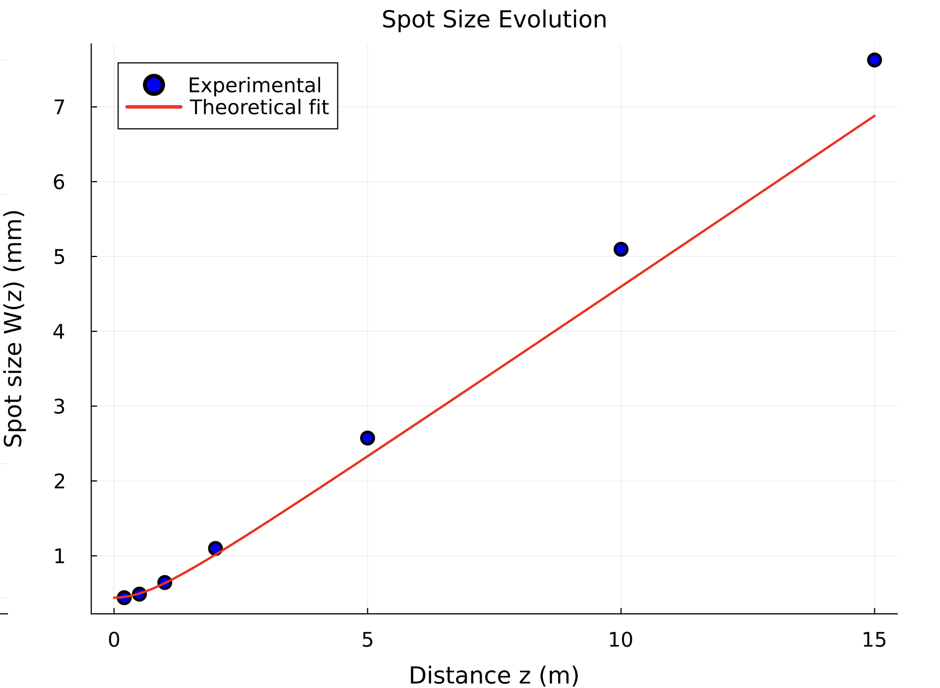
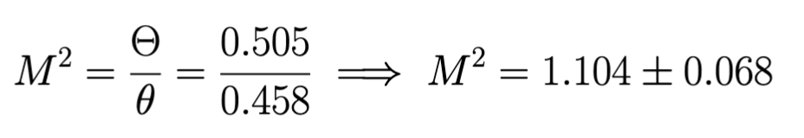
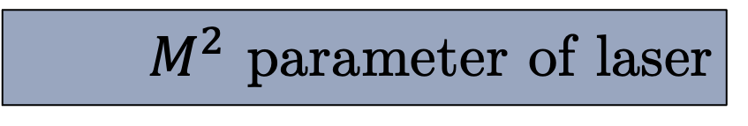
$M^{2}$ parameter of laser

Slide 10
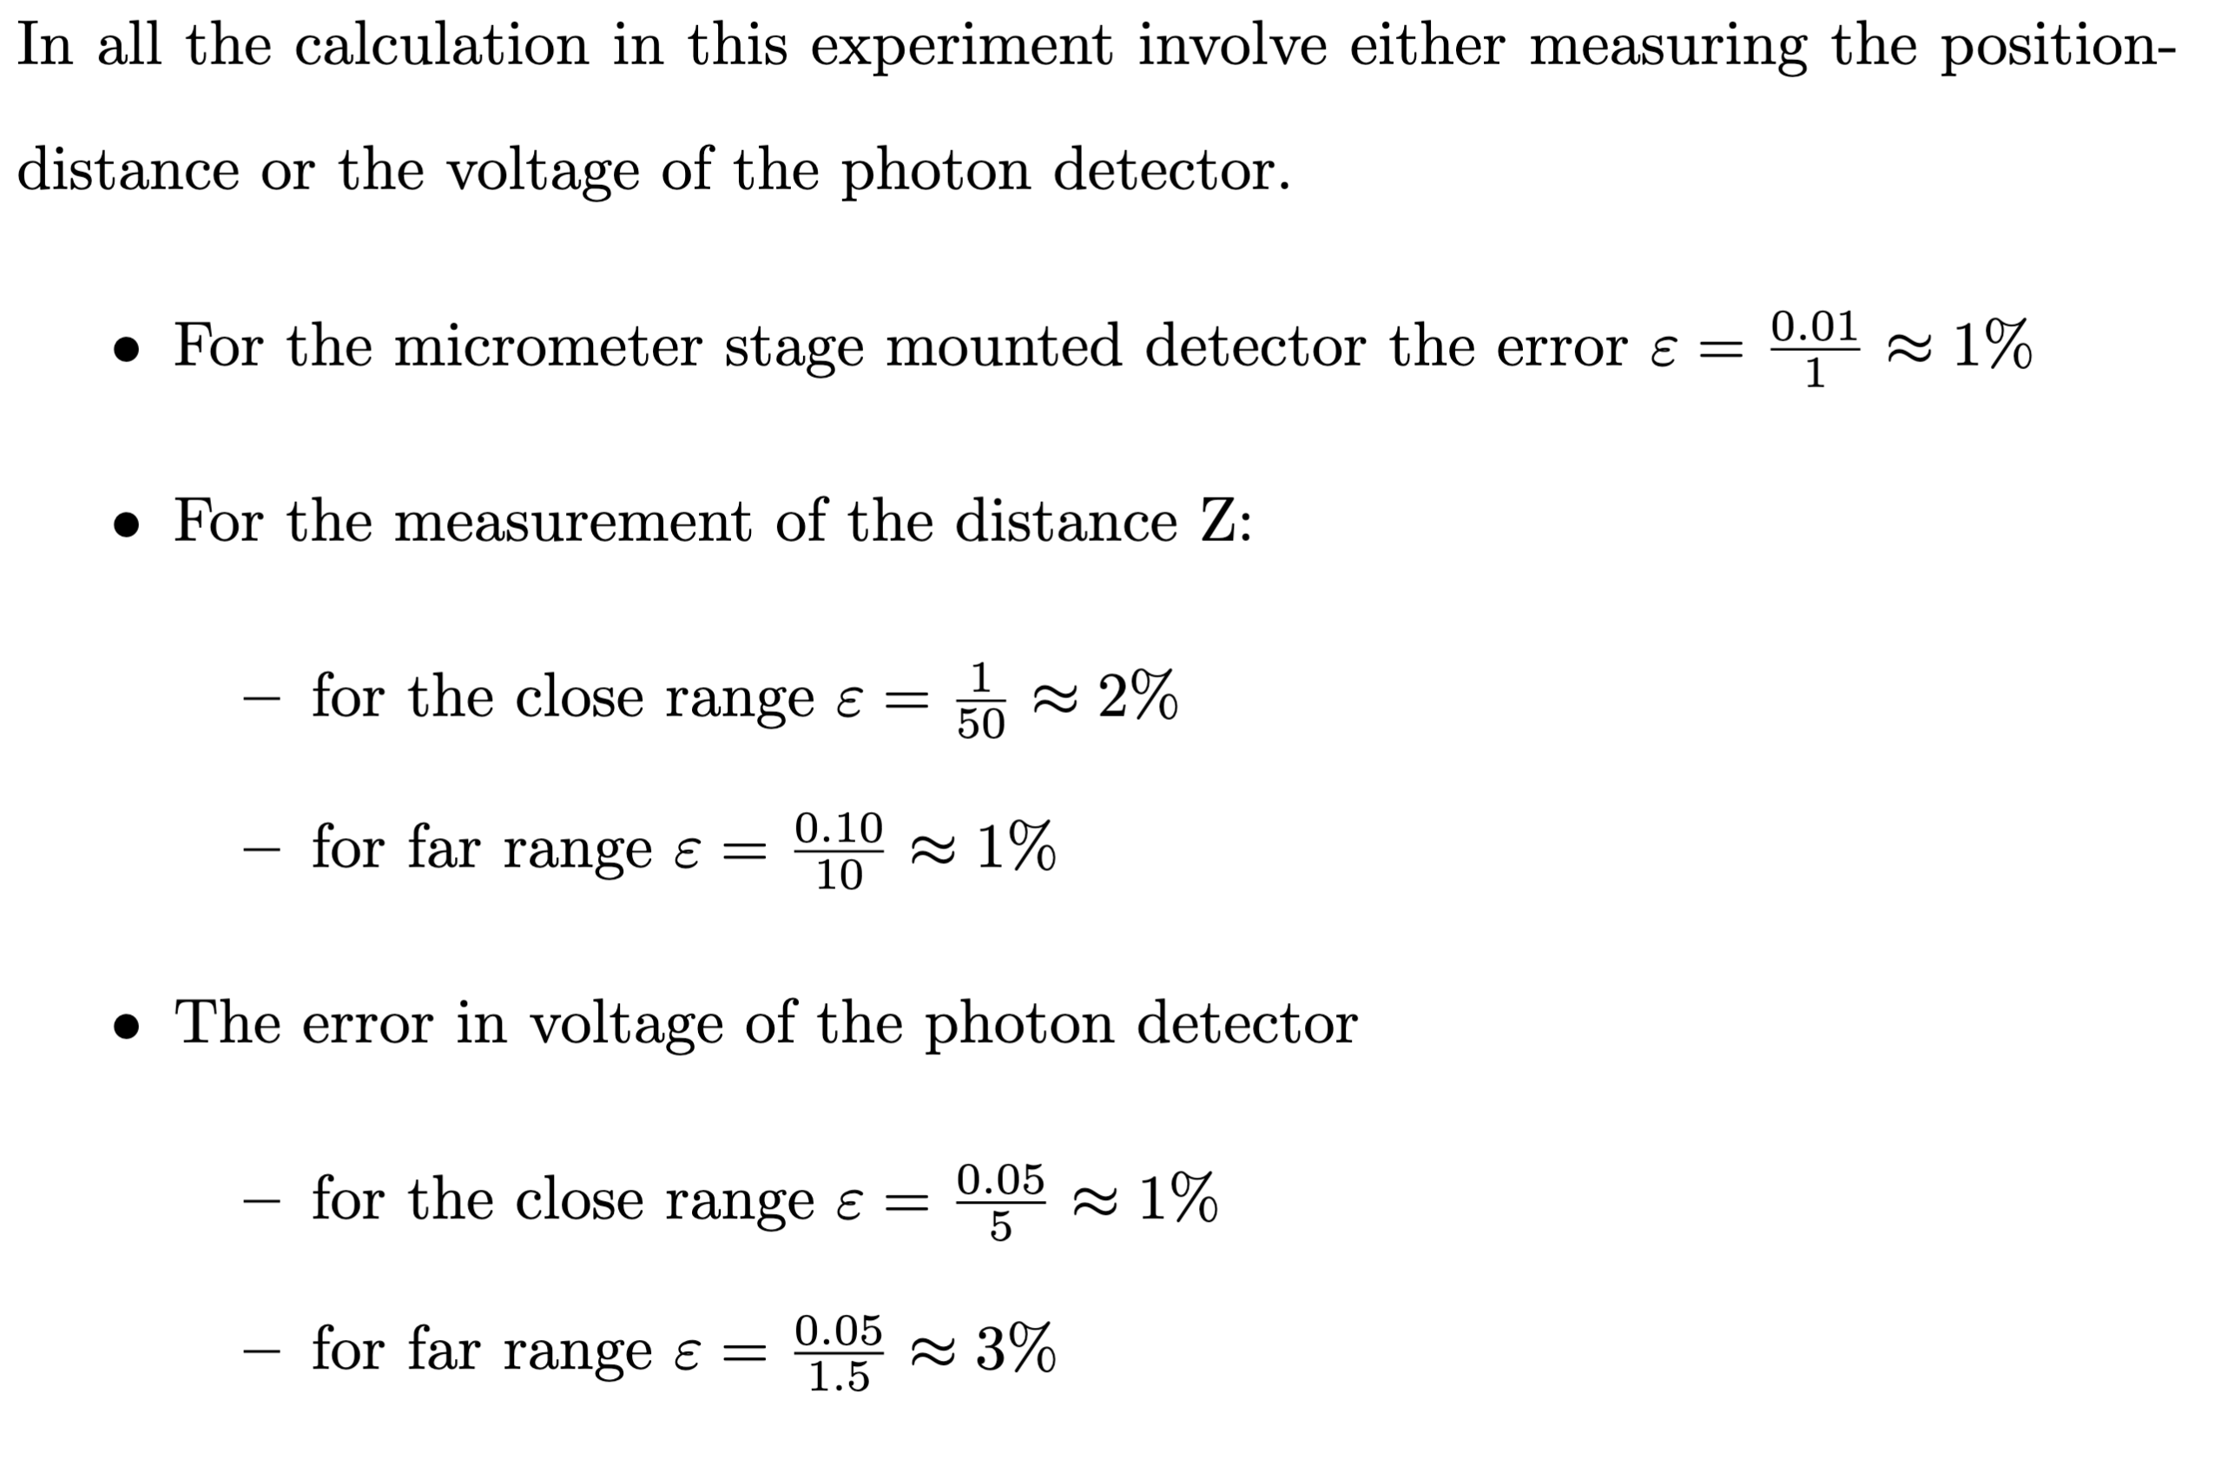
Error Analysis

Slide 11
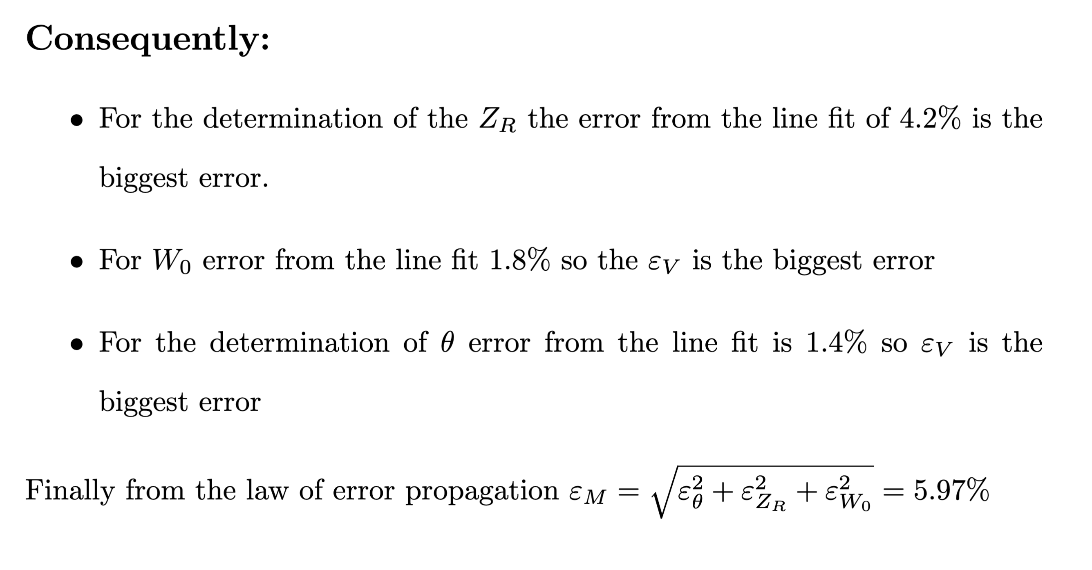
Error Analysis

Slide 12
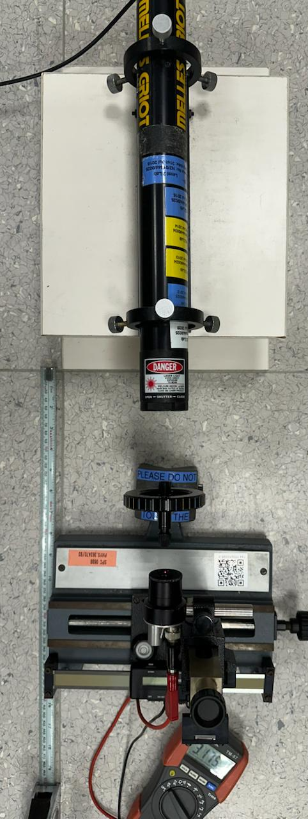
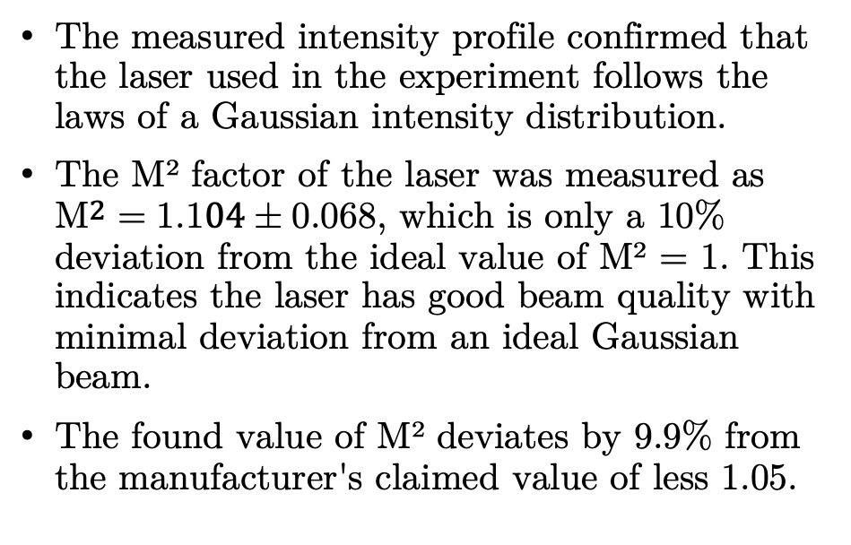
Conclusion
The measured intensity profile confirmed that the laser used in the experiment follows the laws of a Gaussian intensity distribution.
The M² factor of the laser was measured as $M^{2}=1.104±0.068$, which is only a 10% deviation from the ideal value of M² = 1. This indicates the laser has good beam quality with minimal deviation from an ideal Gaussian beam.
The found value of M² deviates by 9.9% from the manufacturer's claimed value of less 1.05.
Notes:
In conclusion, we have characterized the rayleigh range, divergence of M^2 parameter of this Helium Neon Light. Some possible improvement that we could make is to make the polarizer smaller so that data at small distance can be taken as well. You see.. This will allow a better measurement of rayleigh range since the gaussian approximation works best at small distance. A second possible sources of error arises from the align of the laser to the detector. In this experiment, we check the alignment of the reflection beam from the detector with the incident one. But at large distance, this is not very

Slide 13
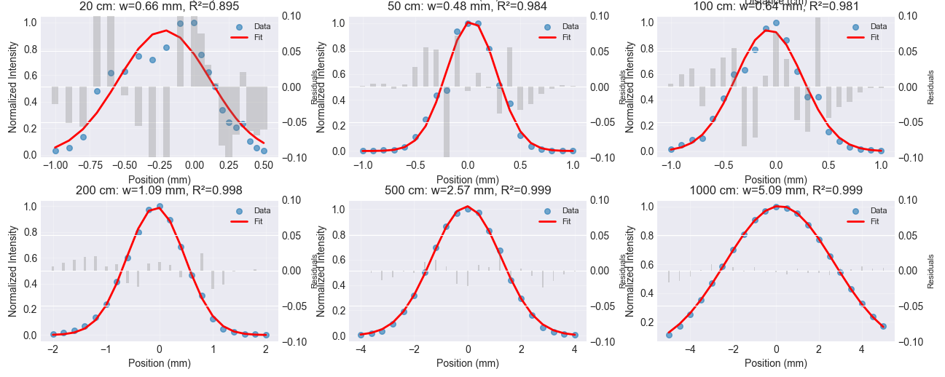
Sources of Error
Detector is manually placed and alignment is ensured by only checking the reflection of beam with our eyes.
The voltmeter saturated very quickly and that led us to take many sets of wrong readings

Slide 14
Thank You!
Parth Bhargava · A0310667E
Open for Questions
Notes:
Good afternoon Gentlemen, today I will be presenting on the propagation of laser light. So, in most laser application,
the beam can be estimated as a Gaussian beam, and the task is to investigate how the spot size increases with increasing distance, and to determine the M^2 parameter
of the laser.

